Slide 1

Secure LAN File Transfer with Audit
Ensuring Data Confidentiality, Integrity, and Auditability

Slide 2



Introduction
Why Secure File Transfer Matters on a LAN
In today's interconnected enterprise environments, local area networks (LANs) are the backbone for internal data exchange. However, traditional file sharing methods often lack the robust security and accountability features necessary to protect sensitive information from unauthorized access, modification, or leakage. This vulnerability poses significant risks to data privacy, regulatory compliance, and business continuity.
Data Breach Risks
Regulatory Compliance
Insider Threats
Unsecured transfers can lead to exposure of sensitive intellectual property or personal data.
Meeting stringent requirements like GDPR, HIPAA, or SOX demands traceable and secure data handling.
Malicious or accidental misuse by internal actors requires stringent access controls and monitoring.

Slide 3
Project Overview
Core Objectives for Enhanced Security
Our secure file transfer solution for LAN environments addresses critical organizational needs:
1
Confidentiality
2
Integrity
Ensuring data remains private and accessible only to authorized individuals throughout its lifecycle.
Guaranteeing that files are not altered or corrupted during transfer, maintaining their original state.
3
Auditability
4
Security
Providing a comprehensive, immutable record of every file transfer activity for compliance and forensic analysis.
Implementing robust mechanisms to protect against unauthorized access, data loss, and cyber threats.

Slide 4
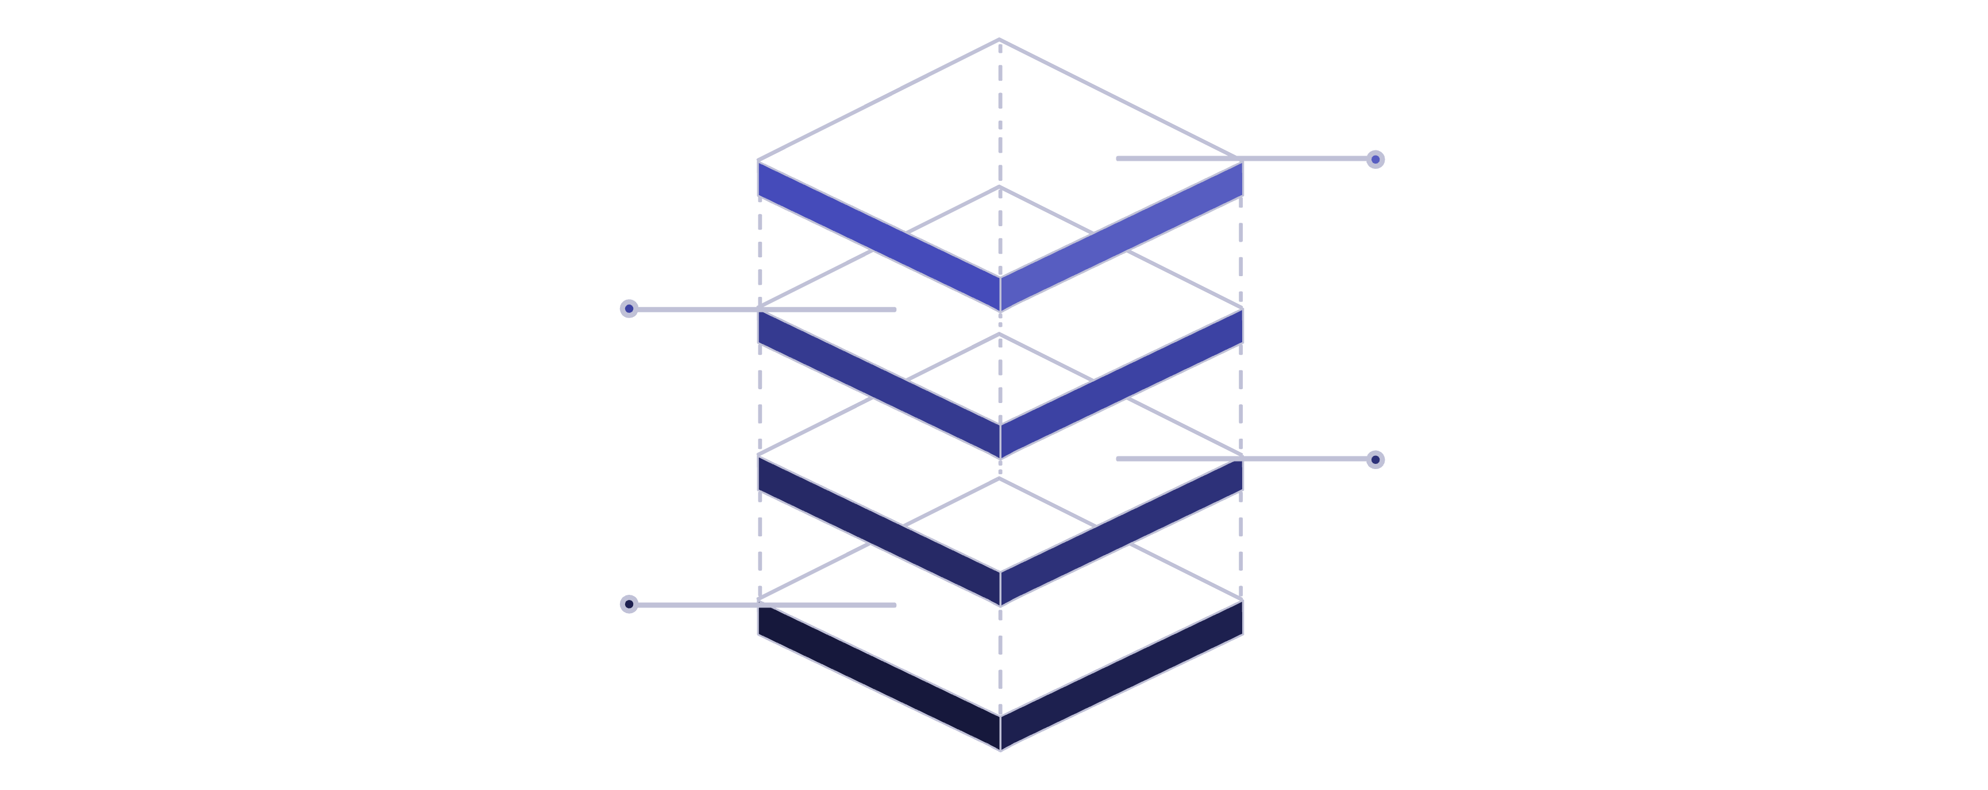
Architectural Design
System Architecture Overview
Security Layer
Encapsulates and protects components
Audit Database
Stores transfer logs and events
File Transfer Server
Handles upload and download
Client
End-user initiating transfers
The architecture is designed for modularity, resilience, and maintainability. It segregates critical functions to enhance security and simplify management.

Slide 5

Security in Depth
Key Security Mechanisms
Encryption
Utilizes robust algorithms (e.g., AES-256) for data in transit and at rest, ensuring confidentiality.
Authentication
Verifies user identities through strong credentials, often integrating with existing directories (e.g., LDAP).
Authorization
Enforces granular access controls, defining precisely which users or groups can perform specific actions on files.
Integrity Check
Employs cryptographic hashing (e.g., SHA-256) to detect any unauthorized modification of files during transfer.

Slide 6

Accountability & Compliance
Comprehensive Audit & Logging
What Gets Logged:
User login/logout attempts (success/failure)
File upload/download activities (who, what, when, from where)
File deletion/modification attempts
Access control changes
System errors and security alerts
How Logs Are Stored:
Centralized, immutable audit database (e.g., PostgreSQL)
Time-stamped and digitally signed for non-repudiation
Secured with strict access controls
Why It Matters:
Compliance: Meets regulatory requirements for data handling and accountability.
Forensics: Provides a clear trail for investigating security incidents or data discrepancies.
Troubleshooting: Helps diagnose system issues and user errors efficiently.
Risk Management: Identifies patterns of misuse or potential vulnerabilities.

Slide 7

Process Flow
Secure File Transfer Workflow
Initiate Transfer
Authenticate
Encrypt & Transfer
Verify & Audit
Each step ensures data protection and transparency, from initiation to completion.

Slide 8
Impact & Application
Advantages & Real-World Use Cases
Key Advantages:
Real-World Applications:
Enhanced Security: Reduces risk of data breaches and unauthorized access.
Financial Institutions: Secure exchange of sensitive customer data and transactions.
Improved Compliance: Simplifies adherence to data protection regulations.
Healthcare: HIPAA-compliant transfer of patient records and medical images.
Operational Efficiency: Streamlines secure internal data exchange.
Legal Firms: Confidential sharing of legal documents and case files.
Increased Accountability: Comprehensive audit trails provide full transparency.
Manufacturing: Secure distribution of blueprints and intellectual property across internal departments.

Slide 9





Underlying Technologies
Recommended Protocols & Tools
TLS (Transport Layer Security)
SFTP (SSH File Transfer Protocol)
Ensures secure communication over the network, encrypting data in transit.
Provides secure file access, transfer, and management over any reliable data stream.
AES-256 (Advanced Encryption Standard)
SHA-256 (Secure Hash Algorithm)
Robust symmetric encryption for data confidentiality.
Used for cryptographic hashing to verify data integrity.
PostgreSQL
LDAP (Lightweight Directory Access Protocol)
Reliable and scalable open-source relational database for audit logs.
Facilitates integration with existing user directories for authentication.

Slide 10

Looking Ahead
Conclusion & Future Scope
Scalability
1
Designing for growth to handle increasing data volumes and user loads.
Cloud Integration
2
Exploring hybrid deployments for secure transfer between on-premise and cloud environments.
AI-Driven Monitoring
3
Implementing machine learning for anomaly detection and proactive threat intelligence in audit logs.
Automated Compliance Reporting
4
Developing tools for automatic generation of regulatory compliance reports from audit data.
This secure file transfer solution provides a robust foundation for protecting sensitive data on your LAN, ensuring both security and compliance. Our future roadmap focuses on continuous improvement and adaptation to evolving security landscapes.

